Slide 1
Housing Market
Tamara Hundich

Slide 2
Original Plan: Create a model that would predict the home value price
Issue: Median sales price was not constant, therefore skewed results. Changed to categorical value.
New Plan: Can a model be created to predict the correct property type?

Slide 3
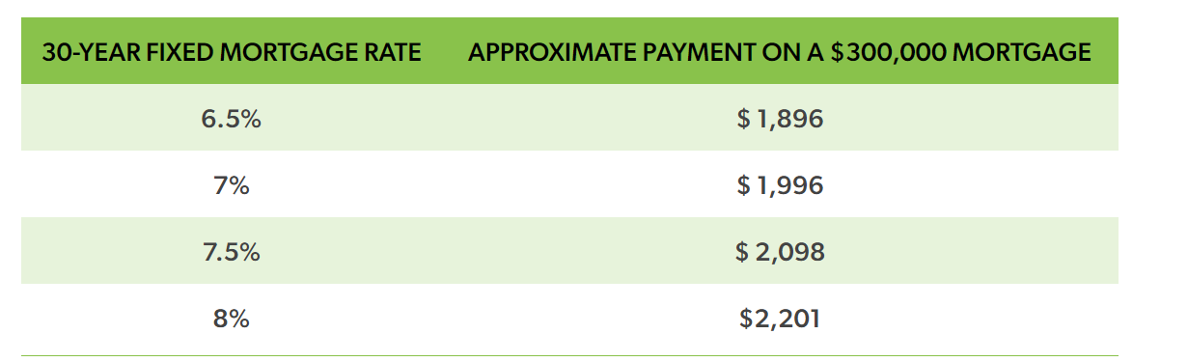
Why?
Per Freddie Mac, the current interest rate for a 30-year FRM mortgage is 6.88% and a 15 yr FRM is 6.22%. Is now the right time to purchase?

Slide 4





PROPERTY TYPES
MULTIFAMILY (2-4 UNITS)
CONDO
TOWNHOUSE
ALL RESIDENTIAL
SINGLE FAMILY RESIDENT

Slide 5
What was included in the Data?
Some examples include:
Month & Year for sale of property
Median Sales Price
&
Median List Price
Number of inventory
All 50 states and Washington D.C.

Slide 6
Data Models

Slide 7
Models Created
Linear Regression
Neural Network
Kmeans Clustering

Slide 8
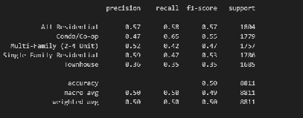
LINEAR REGRESSION
Even though the desired accuracy was 75%, this was the best fit model for this dataset.
50% Accuracy Rating

Slide 9
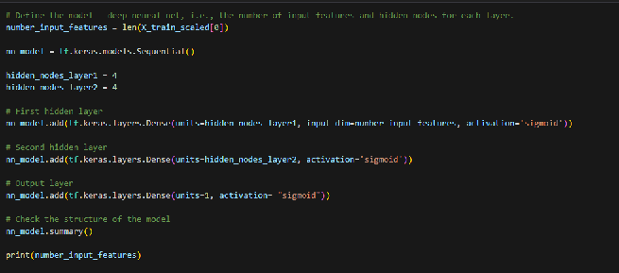

NEURAL NETWORK

Slide 10

NEURAL NETWORK ORIGINAL CODE
50 Epochs
2 Hidden Nodes Layers
Activation: Sigmoid
Loss: Binary Crossentropy
20% Accuracy Rating

Slide 11


STRATEGY
1
2
3
4
5
CHANGING LOSS
Reasearched online instead of binary: categorical
ADDED ADDITIONAL NODE LAYER
CHANGED ACTIVATION
ADDED COLUMNS
CHANGED EPOCHS
Even with all these changed, the accuracy rating either decreased or remained at 20%.

Slide 12
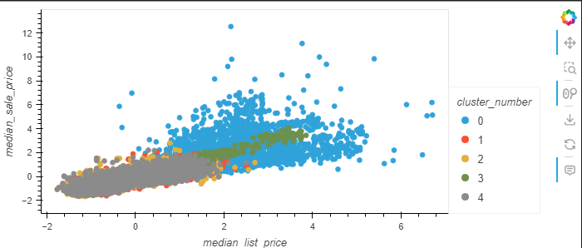
KMEANS CLUSTERING
Clustered by property type
0 = Multi-family 3= All Residential
1= Condo 4= Single Family Resident
2 = Townhouse
Multi-family homes had a higher median sale price
and higher median list price compared to the other
property types.

Slide 13
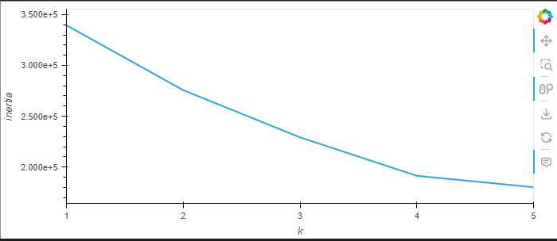
KMEANS
K = 5, since the 0 is missing off graph

Slide 14
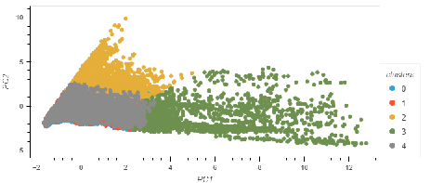
KMEANS

Slide 15
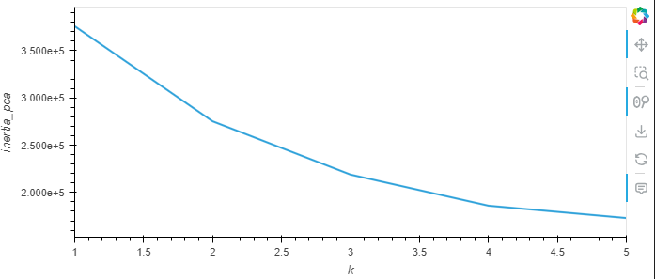
KMEANS

Slide 16
CONCLUSION
LINEAR REGRESSION
NEURAL NETWORK
Despite only have a 50% accuracy rating, the linear regression model was the best fit model.
With the neural network model, even with all changes, the accuracy score still remained at 20%.
OPPORTUNITIES
KMEANS
Looking for a new dataset that may contribute to a higher accuracy rating.
Other opportunity would be to explore a new machine learning model.
Those that were in the cluster 2 had the highest median sale price.
Even with multiple models created, the desired results were not obtained.

Slide 17


RESOURCES
Downloadable Housing Market Data - Redfin
Mortgage rates and affordability - My Home by Freddie Mac

Slide 18
QUESTIONS?

